Slide 1
Reverse engineering the cylinder scanners
Updated: 12/20/2023

Slide 2
Current build: slow scanner

Slide 3
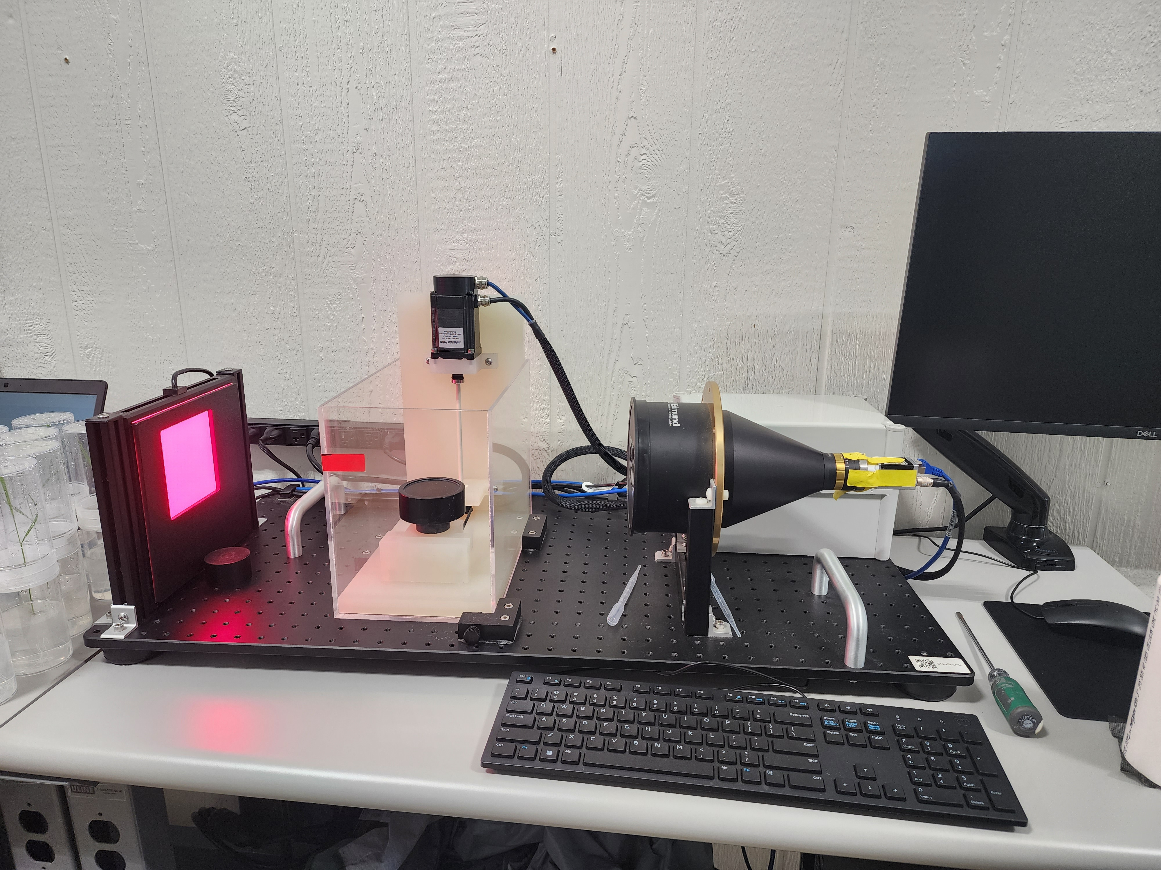
S/N C000271

Slide 4
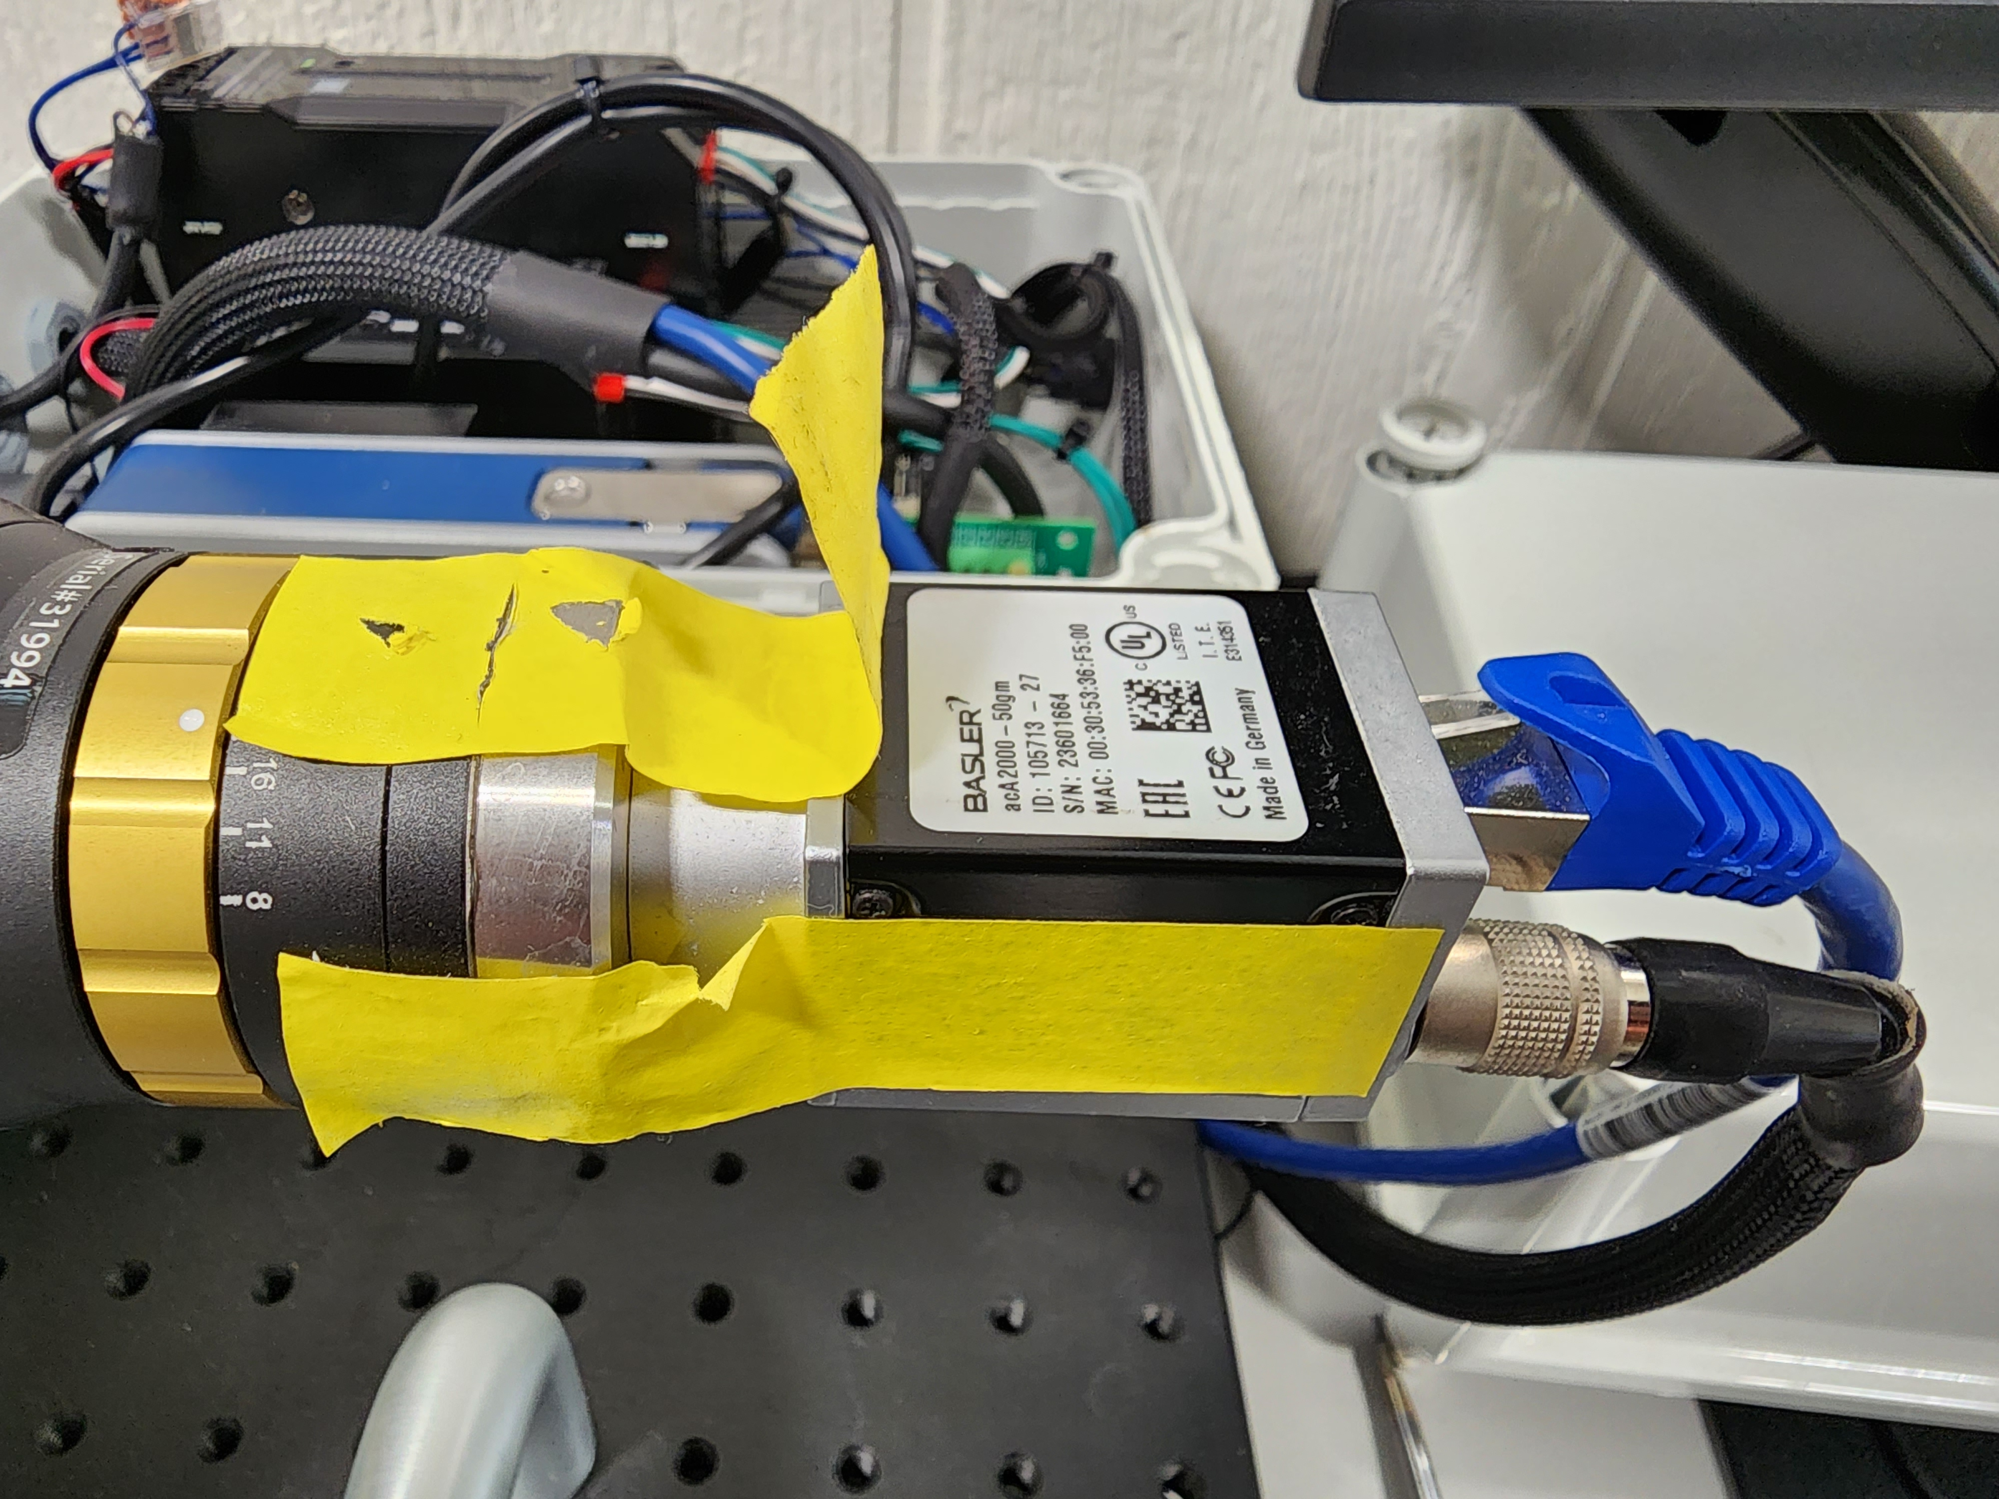
Camera: acA2000-50gm
Connects to computer via GigE ethernet
Camera is powered by six pin I/O and power cable
Power supply is 12V
CMV 2000 Sensor
50 fps Frame rate
2 MP Resolution
Notes:
Issues: GigE is harder to configure than USB
Separate power supply takes up space

Slide 5
acA2000-50gm
Resolution (H x V Pixels) | 2048 x 1088
Resolution | 2 MP
Sensor Type | ams CMV2000-2E5M1BP Progressive scan CMOS Global shutter
Sensor Format | 2/3"
Effective Sensor Diagonal | 12.75 mm
Pixel Size (H x V) | 5.5 x 5.5 μm
Frame Rate (at Default Settings) | 50 fps
Product Family | ace Classic
Mono / Color | Mono
Image Data Interface | Fast Ethernet (100 Mbit/s) Gigabit Ethernet (1000 Mbit/s)
Pixel Formats | See Pixel Format.
Synchronization | Via hardware trigger Via software trigger Via free run
Exposure Time Control | Via hardware trigger Programmable via the camera API
Camera Power Requirements | ≈3.0 W when using Power over Ethernet ≈2.5 W @ 12 VDC when supplied via I/O connector
I/O Lines | 1 opto-coupled input line 1 opto-coupled output line
Lens Mount | C-mount
Size (L x W x H) | 42.0 x 29 x 29 mm (without lens mount or connectors) 60.3 x 29 x 29 mm (with lens mount and connectors)
Weight | <90 g
Conformity | CE (includes RoHS), EAC, UL Listed, FCC, GenICam, GigE Vision, IP30, IEEE 802.3af (PoE), REACH, KC
Software | Basler pylon Camera Software Suite (version 4.0 or higher)
Notes:
https://docs.baslerweb.com/aca2000-50gm

Slide 6
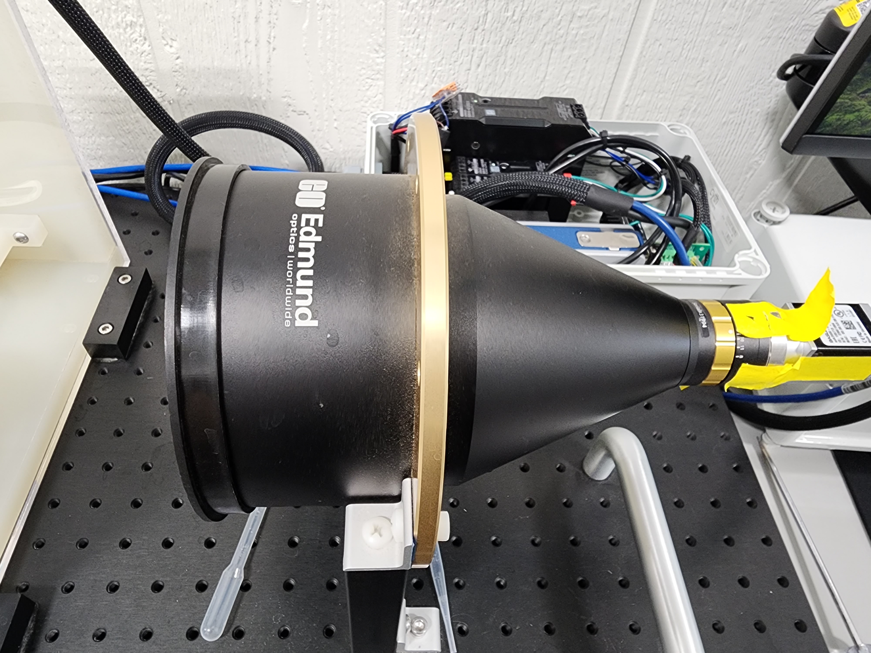
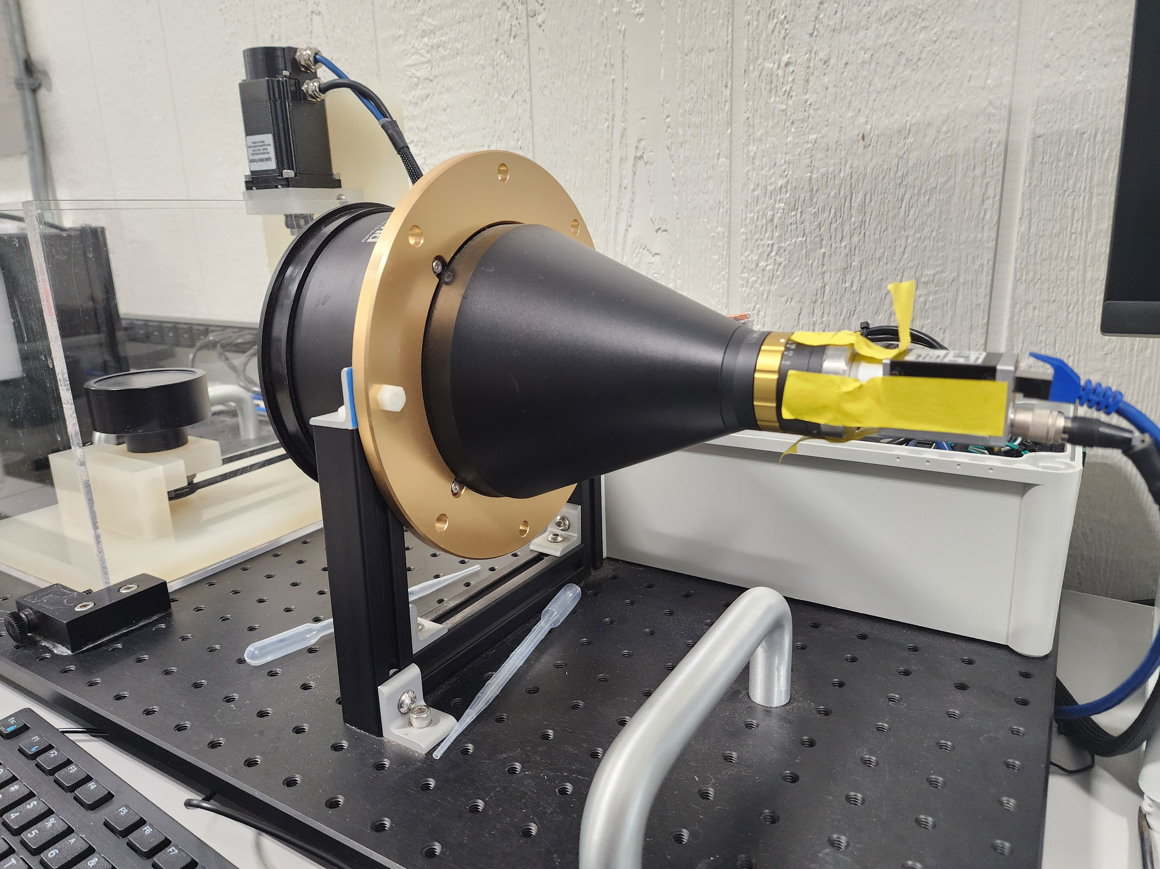
Lens: 0.093X, 2/3" C-Mount TitanTL® Telecentric Lens
Attached to camera
Close to water tank
Mounted to optical breadboard
Entire cylinder and some of the tank is in the field of view
Notes:
https://www.edmundoptics.com/p/0093x-23-c-mount-titantltrade-telecentric-lens/3436/
Issues: lens mounted to optical breadboard but camera I not, which causes the camera to rotate over time

Slide 7
Horizontal Field of View, 1/2" Sensor: 68.5mm Horizontal Field of View, 2/3" Sensor: 94.1mm Weight (kg): 3.46 Numerical Aperture NA, Object Side: 0.0058 Resolution, Image Space: 70 lp/mm @ 40% (MTF, open) Number of Elements (Groups): 6 (4) Horizontal Field of View, 1/1.8" Sensor: 77.0mm Type: Telecentric Lens Primary Magnification PMAG: 0.093X Maximum Sensor Format: 2/3" | Working Distance (mm): 222 Mount: C-Mount Aperture (f/#): f/8 - f/22 Coating: λ/4 MgF₂ Depth of Field (mm): ±45.1mm (20% @ 20 lp/mm, open) FOV @ Max Sensor Format, H x V (mm): 94.6 x 71.0 Resolution, Image Space MTF @ F8: 70 lp/mm @ 40% Rear Filter Diameter (mm): 25.4 Typical Distortion @ 520nm (%): <0.10 Typical Telecentricity @ 520nm (°): <0.1 Lens Wavelength Range: VIS

Slide 8
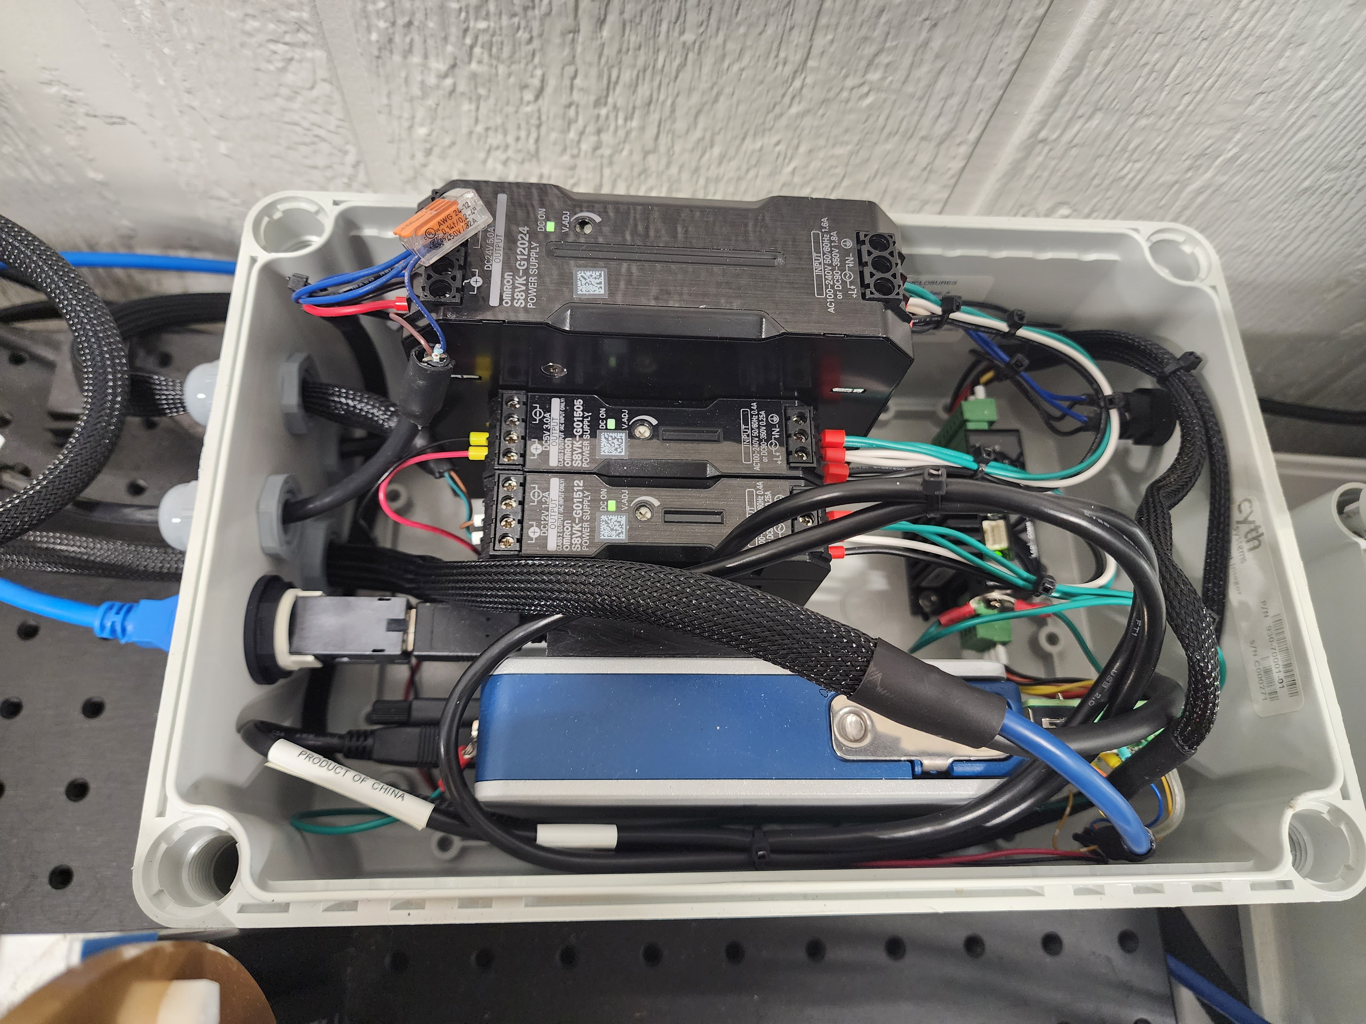
Electrical box
24 V Power supply: light and motor
5 V Power supply: encoder
12 V Power supply: camera
motor driver
USB connection to computer
cDAQ

Slide 9
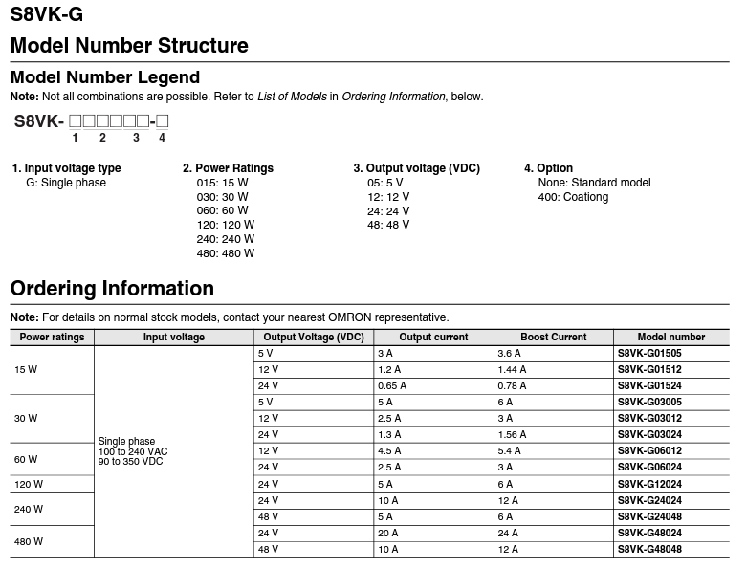
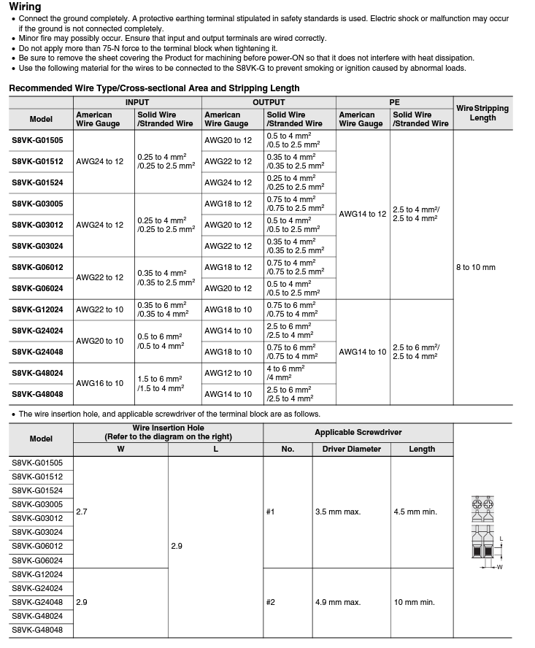
S8VK-G12024 connects to the wall

Slide 10
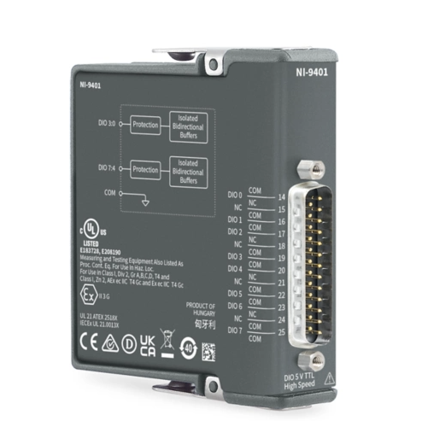
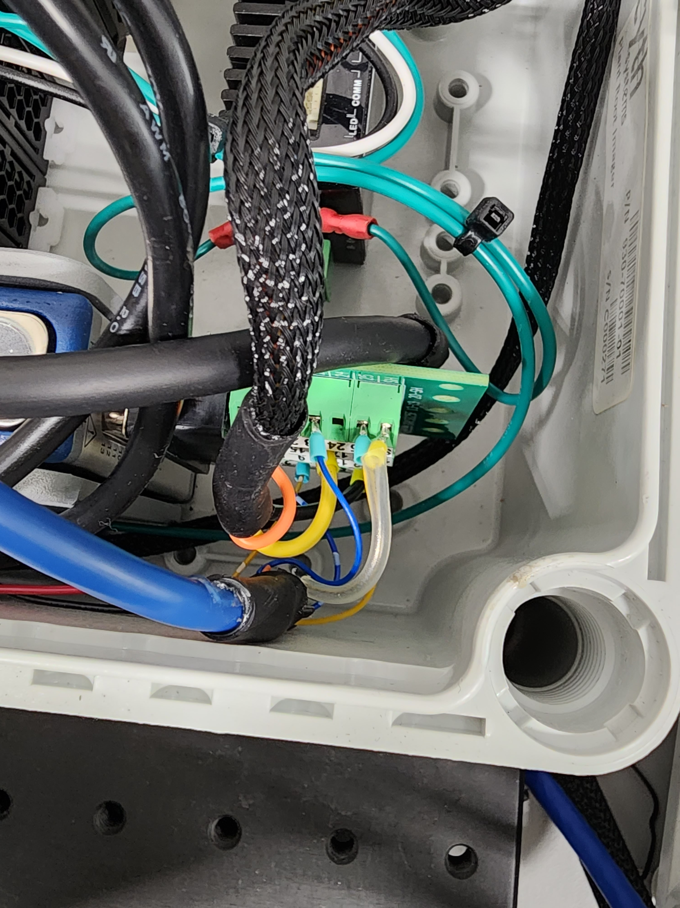
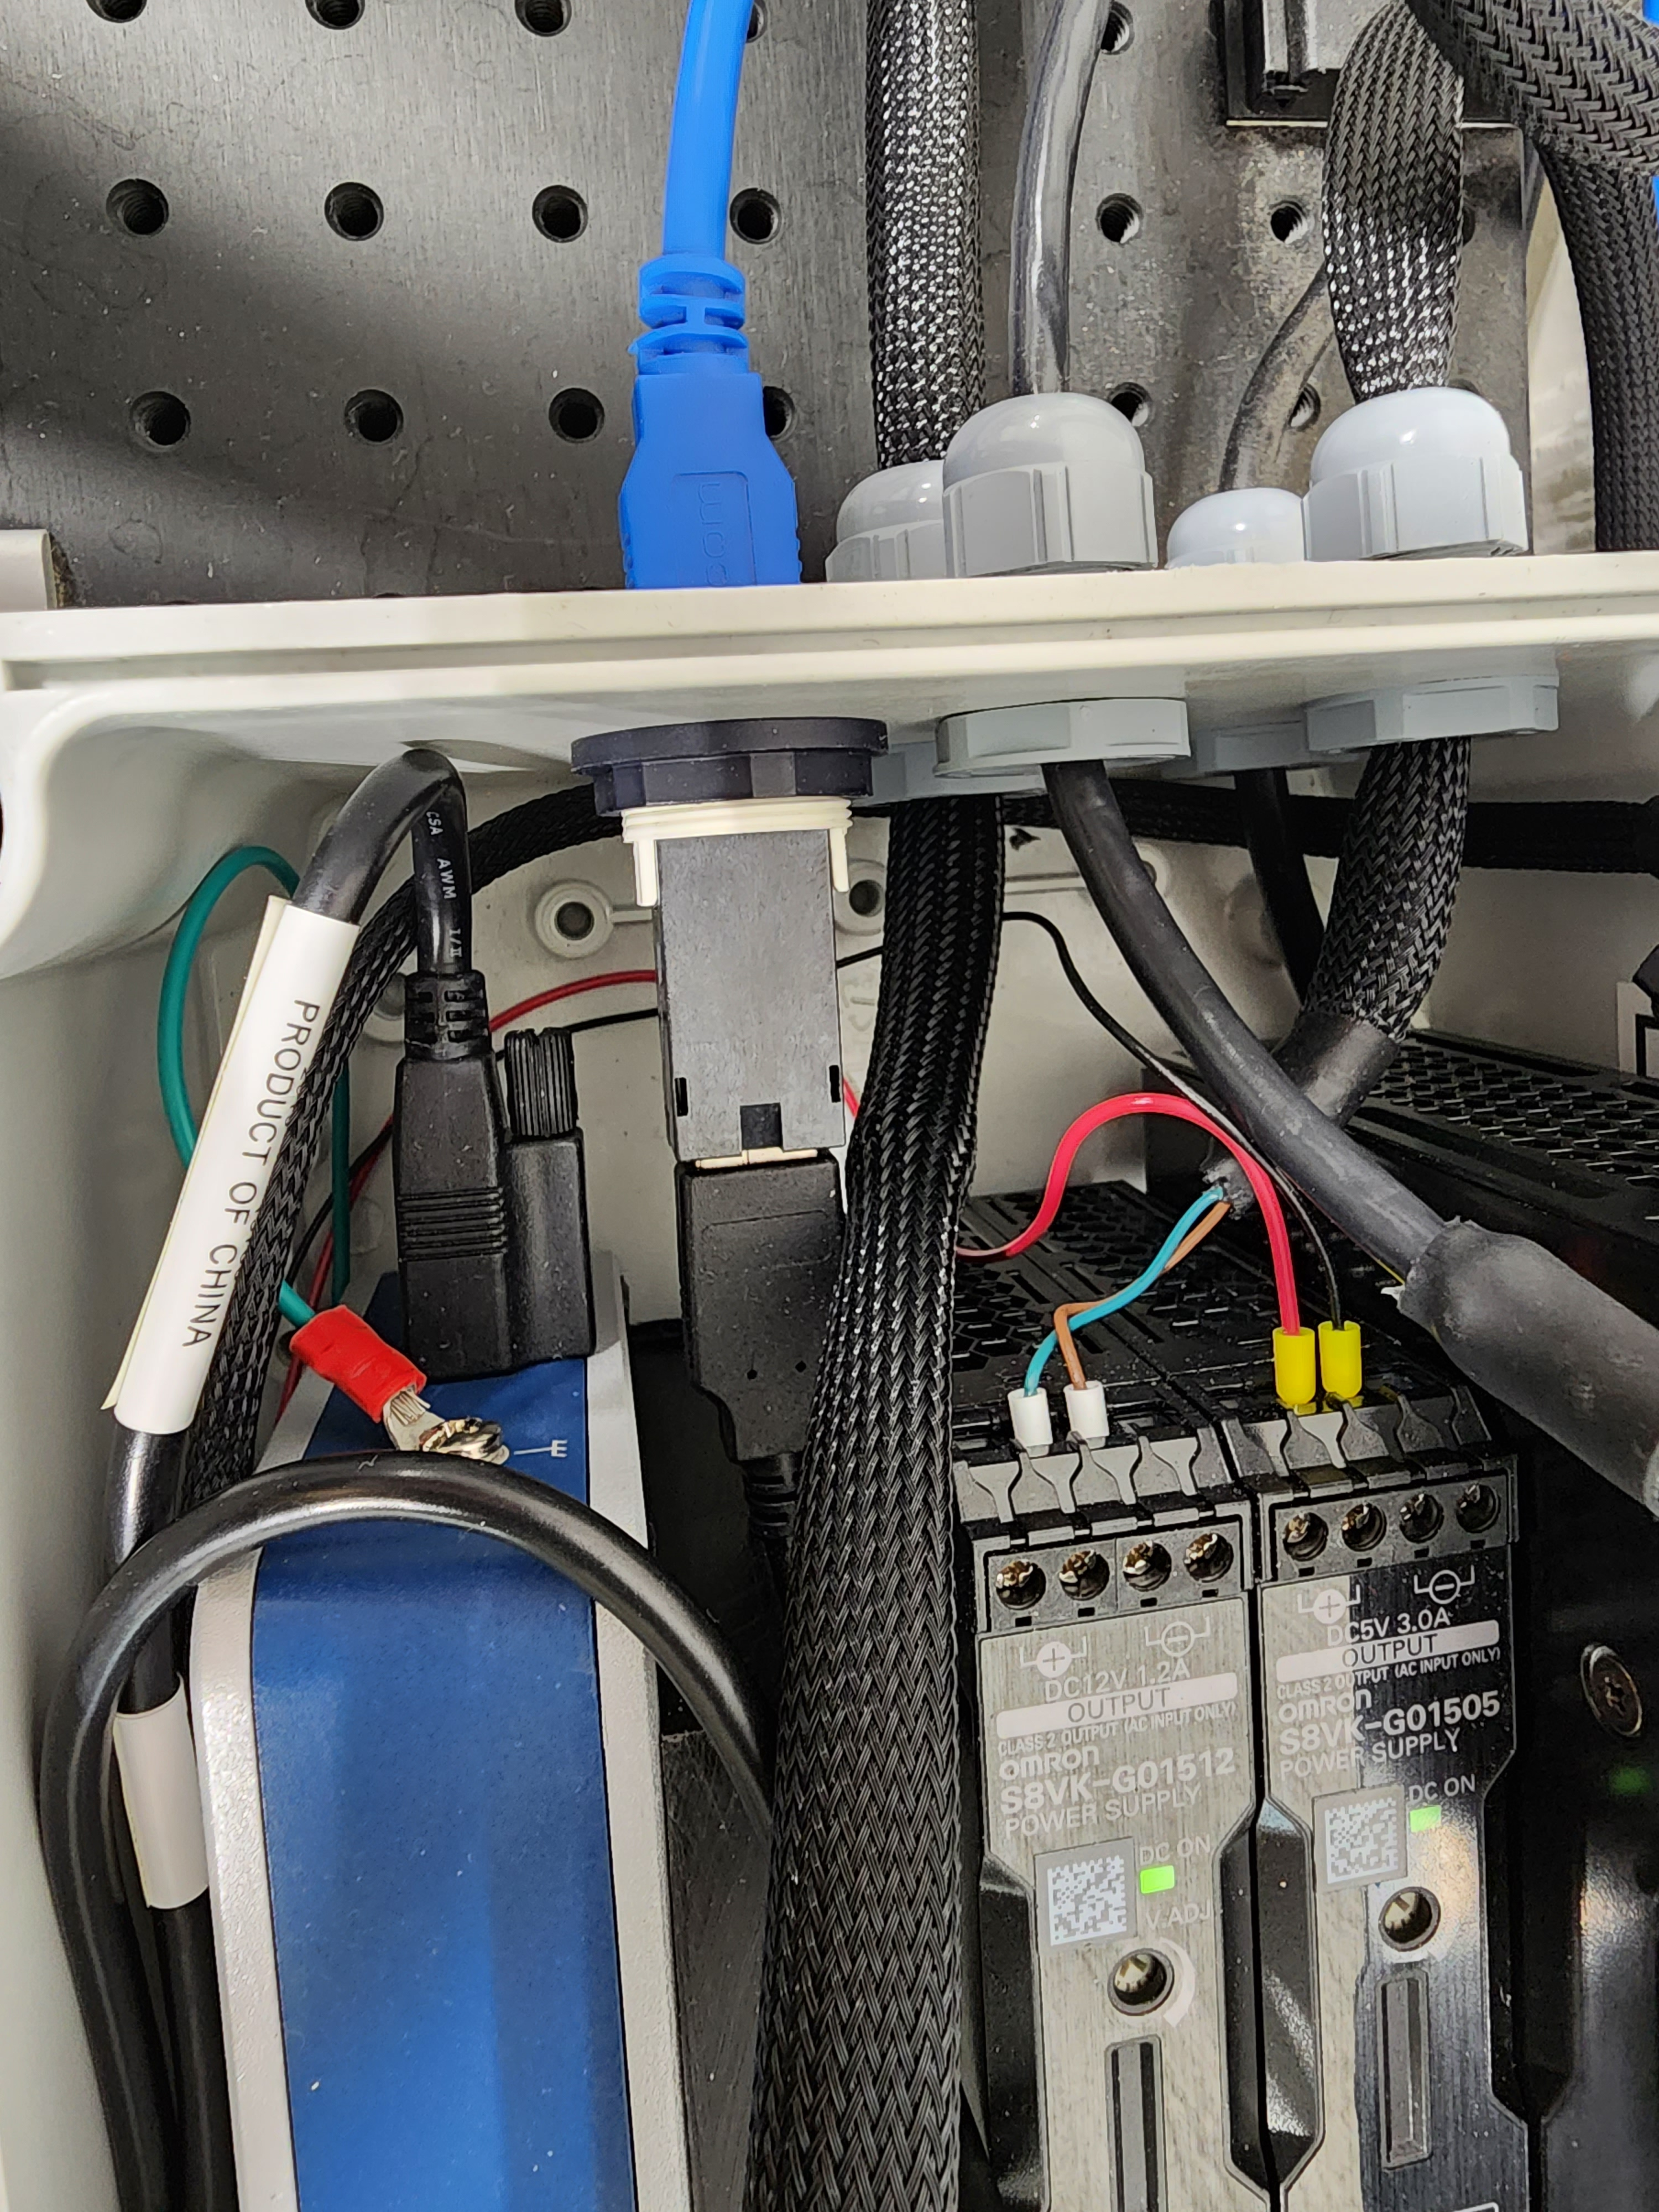
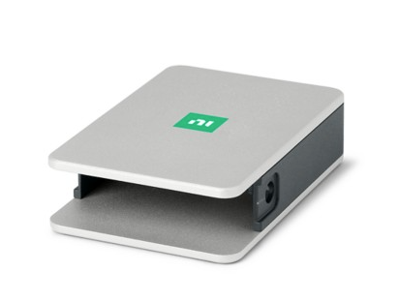
Compact DAQ Chassis
NI-9401: A 5 V/TTL, 8 Bidirectional Channels, 100 ns C Series Digital Module
cDAQ-9171: 1-Slot, USB CompactDAQ Chassis
Read the encoder position and control the stepper motor
Notes:
https://www.ni.com/docs/en-US/bundle/cdaq-9171-specs/page/specs.html
https://www.ni.com/en-us/shop/model/ni-9401.html

Slide 11
Breakout

Slide 12
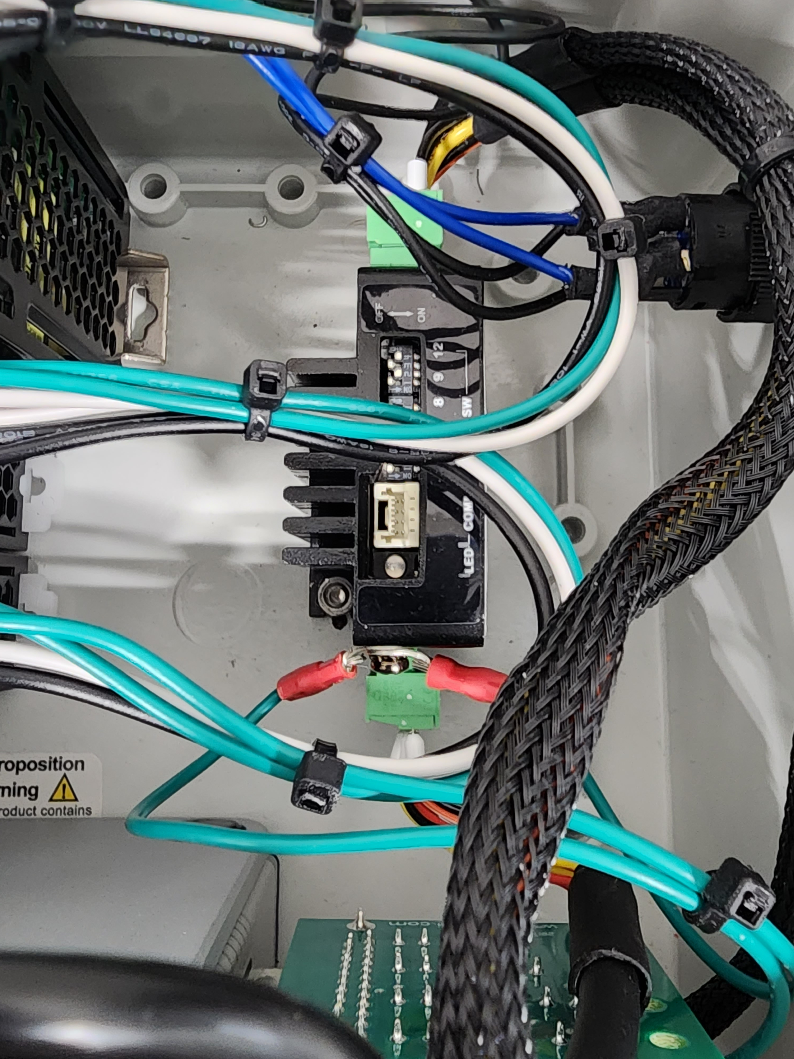
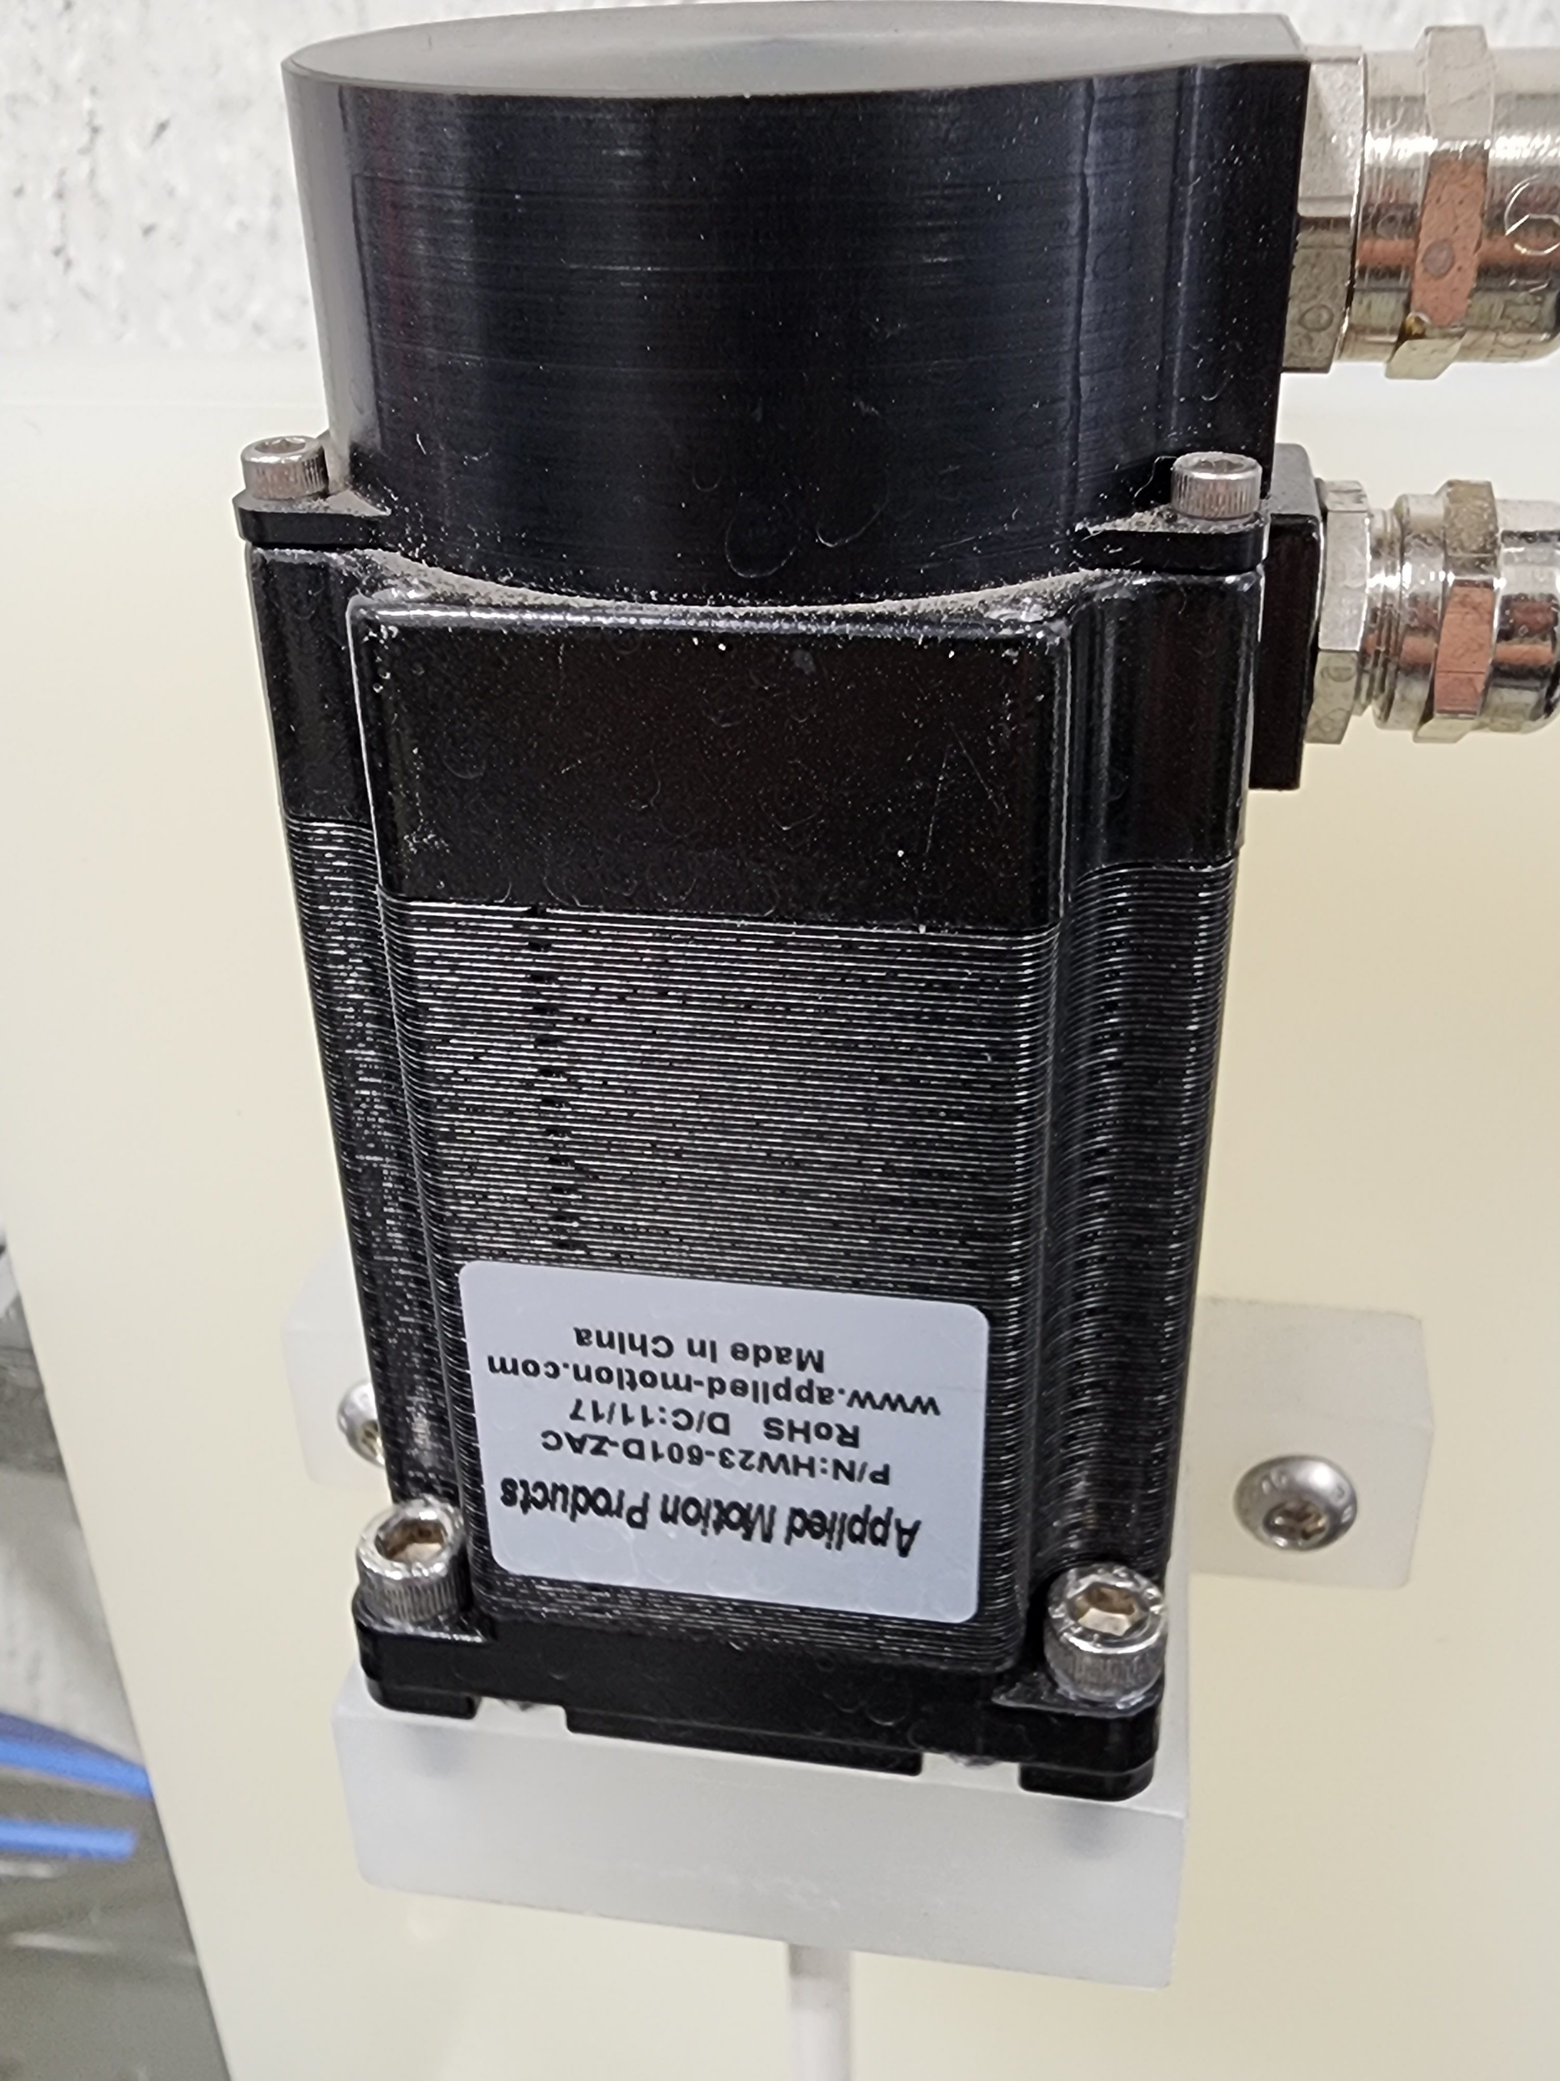
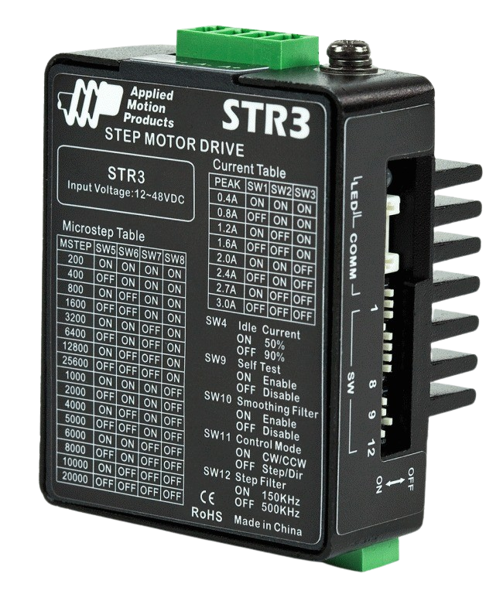
Stepper motor: HW23-598 IP65 Rated, NEMA 23 High Torque
Purchase from applied motion with ZAA encoder attached and covered using product number: HW23-753D-ZAC
Stepper motor connects to shaft which turns gear (42 teeth)
Powered by 24 V power supply (with backlight)
The motor is driven by an Applied motion STR3 stepper motor driver
Notes:
https://www.applied-motion.com/s/product/ip65-rated-step-motorhw23598/01t5i000000xzusAAA?name=HW23-598-IP65-Rated-NEMA-23-High-Torque-Stepper-Motor
https://www.applied-motion.com/s/product/str3-stepper-drive5000231/01t5i000000y1e5AAA?name=STR3-Miniature-Advanced-Microstep-Drive

Slide 13
Frame Size NEMA 23 Motor Type High torque Motor Length 2.34 in Number of Lead Wires 8 Lead Wire Configuration shielded cable, no connector Lead Wire/Cable Length 10 in Lead Wire Gauge 22 AWG Bipolar Holding Torque 158 oz-in Step Angle 1.8 deg Bipolar Parallel Current 4.24 A/phase Bipolar Parallel Resistance 0.5 Ohms/phase Bipolar Parallel Inductance 1.4 mH/phase | Rotor Inertia 3.68E-03 oz-in-sec2 Integral Gearhead No Weight 1.32 lbs Storage Temperature -22 to 158 °F Operating Temperature -04 to 122 °F Insulation Class Class B (130 ºC) Shaft Diameter 0.25 in Bipolar Series Resistance 2 Ohms/phase Bipolar Series Inductance 5.6 mH/phase Category Series IP65 Rated Motor IP Rating IP65

Slide 14
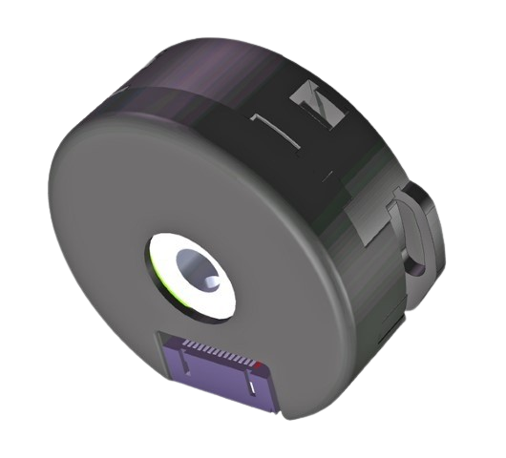
Encoder
The ZAC encoder is the ZAA with a cover.
Renco 35i with 2000 lines, 8000 read in quadrature.
Stepper motors are commutated in physical micro-steps, not encoder counts.
Needs a drive that can read the encoder to take advantage of stall detection/prevention features such as the ST10-Q driver/controller.
Notes:
https://www.applied-motion.com/s/product/encoder-zaa-2000-line9701001/01t5i000000xzJ4AAI?name=ZAA-Incremental-Encoder-for-HT23-and-HT24-Stepper-Motors

Slide 15
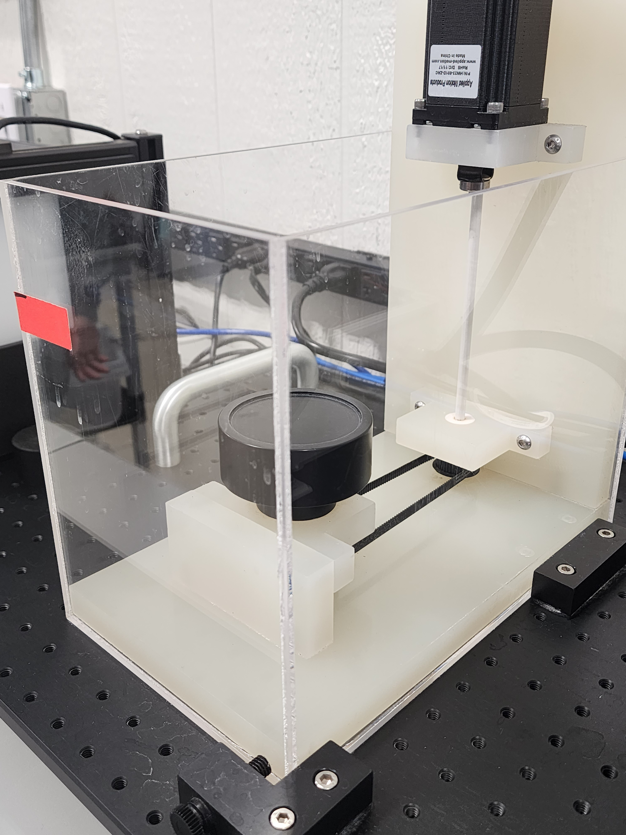
Pulley connects to gear under turn table (60 teeth)

Slide 16
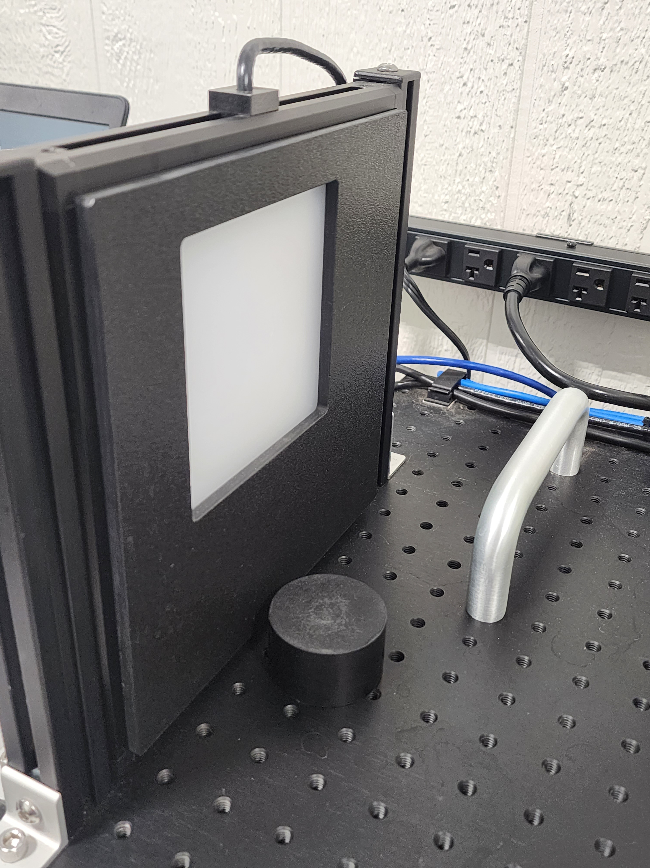
A red 8” x 8” backlight is used to illuminate sample
It is powered by a 24V power supply and connected to the on/off button
Notes:
https://www.advancedillumination.com/products/bl-series/
Advanced Illumination part #: BL0808-66024

Slide 17
Breadboard
A Newport Optical Breadboard Plate, Solid Aluminum, 18 x 36 in., 1 in. 1/4-20 Grid is used to mount all the components of the system as well as allow for adjustments to be made to the working distance

